Slide 1
Introduction to Python
Notes:
1

Slide 2

First steps (installing and manipulating basic commands)

Slide 3
Install Python
This course is based on the latest Python 3 version
Python is an open source, distributed and freely available language
Python can be installed via the installation file from the official website
https://www.Python.org/downloads/mac-osx/ (for macOS)
https://www.python.org/ftp/python/3.8.3/python-3.8.3.exe (for windows)

Slide 4
Install your Python environment
A Python program can easily run on any system. We can write a program on a Notepad and run it on the command prompt.
We can also write and run Python programs on different IDEs (Integrated Development Environment), such as Jupyter Notebook, Spyder and PyCharm. (recommended)
In this course, we are going to use ANACONDA to download additional software such as Spyder, Notebook, etc.
Anaconda can easily be downloaded and installed from https://www.anaconda.com/distribution/.
Once the installation is complete, check your program in the START menu or search for Anaconda in the START menu.

Slide 5
Using Jupyter Notebooks
Jupyter is an acronym that stands for Julia, Python and R. Initially, the developers implemented it for these 3 languages, but now it is used for various others including C, C++, Scala, Perl, Go, PySpark, Haskell,…
Jupyter Notebook is a web application that’s used to create data analysis notebooks that contain code, text, figures, links, mathematical equations and charts.
A same cell can contain several lines of code
The notebooks can be run locally, or we can make them available online by running a dedicated notebook server
Certain cloud computing solutions, such as Wakari, PiCloud and Google Collaboratory allow you to run notebooks in the cloud.
Jupyter can be downloaded from Anaconda
JupyterLab is a next-generation web-based user interface. It offers a combination of data analysis and machine learning product development tools such as TextEditor, Notebooks, Code Consoles and Terminals (out of scope – today)

Slide 6
Hands-on (Primer_Jupyter)
Mi primer heading
Una simple calculadora (+, -, *, /)
Operadores de comparación
Control de flujo
String
Sopa de letras
Formateando cadenas de caracteres
Listas
Bucles
Funciones
¿Que son los limites de Notebook?

Slide 7
Help function
As you start to code, you will soon find questions that we do not answer
Function Help
If you get stuck, start with Google. Typically adding “Python” to a query is enough to restrict it to relevant results:
If the search isn’t useful, it often means that there aren’t any Python-specific results available.
Chances are that someone else has been stuck in the past, and there will be help somewhere on the web.
If Google doesn’t help, try stackoverflow.
Start by spending a little time searching for an existing answer, including [Python] to restrict your search to questions and answers that use Python.

Slide 8
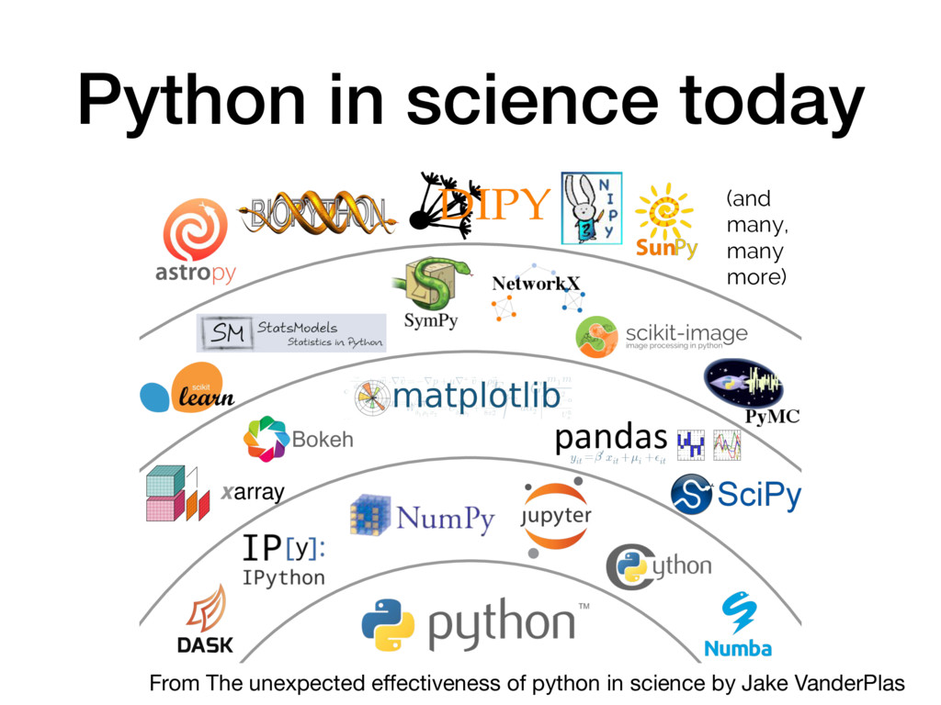
Libraries: adding more functions to your Python
Numpy is a library for large, multi-dimensional arrays and matrices, along with a large collection of high-level mathematical functions to operate on these arrays.
Pandas offers data operations for analysis
Matplotlib is a plotting library as an extension of Numpy.
SciPy contains modules for optimization, clustering, linear algebra, interpolation and image processing

Slide 9
Install and import library in Jupyter
In Jupyter, you can use the command:
!pip install “name of the library”
Import a module function
Map a module function
Example with ‘math’

Slide 10
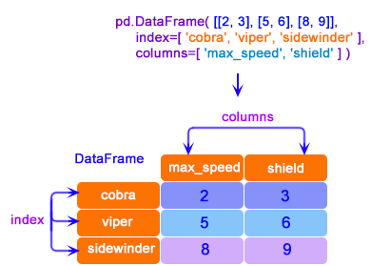
Second Jupyter
Creating data

Slide 11
Second Jupyter
Reading and writing CSV files with Pandas
Syntax is : “Name of the library” + “function”
Ex: pandas.read_csv or pd.read_csv
Idem for Excel
Idem for JSON (JavaScript Object Notation)
JSON is a widely used format for interchanging data among web applications and servers. It is more readable compared to XML.
The ‘orient’ parameter is used to handle the output string format. It offers record, column, index, and value kind of formats.

Slide 12
Third Jupyter
Analyze a data frame
List of columns
Shape
Information: we can check the table schema and missing values in the dataframe
Age, income and gender have missing values

Slide 13
Reference
Navlani, A. ; Fandango, A. and Idris, I. Python Data Analysis. Packt. Birmingham-Mumbai. (2021). Third Edition. ISBN: 978-1-789995-524-8.

